Slide 1

Math Olympiad Contests
1:20 – 2:05 PM
CONTEST | Div. M
1 | Nov 19, 2010
2 | Dec 17, 2010
3 | Jan. 14, 2012
4 | Feb 11, 2012
5 | Mar 10, 2012

Slide 2
7th
What is the number of cubic inches in cubic foot?
.

Slide 3
7th
What is the number of cubic inches in cubic foot?
1 foot = 12 inch
1 cubic foot = 12 x 12 x 12 cubic inches
= 1728 cubic inches
.

Slide 4
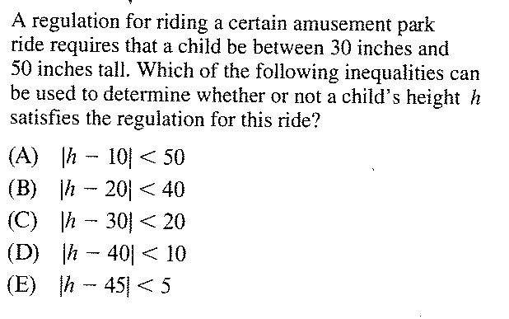
7th

Slide 5
7th
D

Slide 6
What is the units digit of 1,234,567¹²³⁴⁵⁶⁷?

Slide 7
What is the units digit of 1,234,567¹²³⁴⁵⁶⁷?
Hint:
7¹ = 7, which has units digit of 7
7² = 7 x 7 = 49, which has units digit of 9
7³ = 7 x 7 x 7 = 343, which has units digit of 3
7⁴ = 7 x 7 x 7 x 7 = 2401, which has units digit of 1

Slide 8
What is the units digit of 1,234,567¹²³⁴⁵⁶⁷?
Hint:
7¹ = 7, which has units digit of 7
7² = 7 x 7 = 49, which has units digit of 9
7³ = 7 x 7 x 7 = 343, which has units digit of 3
7⁴ = 7 x 7 x 7 x 7 = 2401, which has units digit of 1
75 = 7 x 7 x 7 x 7 x 7 = 16807, which has units digit of 7
1234567/4 = 308641R3
1,234,567¹²³⁴⁵⁶⁷ = 7³ = 3

Slide 9
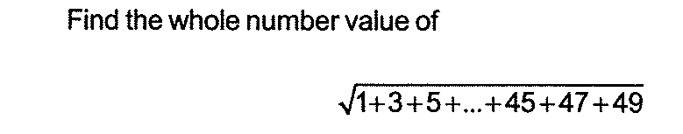

Slide 10
1, 2, 3, 4, …. 49: 49 numbers
2, 4, 6, ……48: 68/2 + 1 = 24 numbers
1, 3, 5, …. 49: 49 – 24 = 25 numbers
(1 + 49) + (3 + 47) + (4 + 45) +…..25
= 12 x 50 + 25 = 600 + 25 = 625
Square root of 625 is 25

Slide 11
Factors
What is the least number with exactly 8 factors?

Slide 12
Factors
What is the least number with exactly 8 factors?
30: 1, 2, 3, 5, 6, 10, 15, 30

Slide 13
Homework
If A : B = 3 : 5, B : C = 7 : 1, C : D = 4 : 9, find A : B : C : D.

Slide 14
Homework
If A : B = 3 : 5, B : C = 7 : 1, C : D = 4 : 9, find A : B : C : D.
A : B = 3 : 5 = 21 : 35
B : C = 7 : 1 = 35 : 5
A : B : C = 21 : 35 : 5 = 84 : 140 : 20
C : D = 4 : 9 = 20 : 45
A : B : C : D = 84 : 140 : 20 : 45

Slide 15
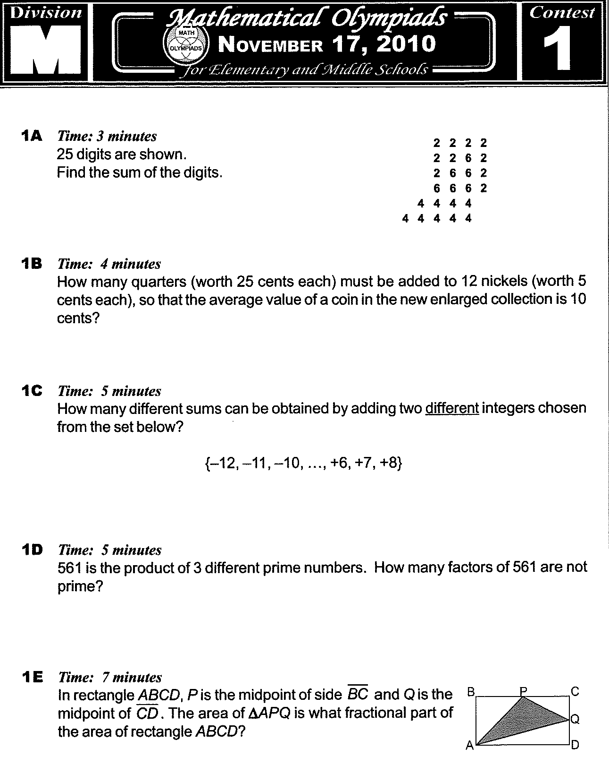

Slide 16
Greatest sum: 7 + 8 = 15
Smallest sum: -12 + (-11) = -23
Total = 15 – (-23) + 1 = 39

Slide 17
Numbers
How many distinct sums can be obtained by
Adding two different integers from the
consecutive even integers from -12 to 8,
inclusive ?

Slide 18
Numbers
How many distinct sums can be obtained by
Adding two different integers from the
consecutive even integers from -12 to 8,
inclusive ?
Largest number: 8 + 6 = 14
Smallest number: -12 + (-10) = -22
14 – (-22) + 1 = 37 (even and odd)
37/2 = 19 (even integers) (18 odd)
(14,12,10,8,6,4,2,0,-2,-4,-6,-8,-10,-12,-14,-16,
-18,-20,-22)

Slide 19
Ratio
If 9 men can complete a job in 4 days, how long will 8 men take to complete the same job, assuming that all the men are working at the same rate?

Slide 20
Ratio
If 9 men can complete a job in 4 days, how long will 8 men take to complete the same job, assuming that all the men are working at the same rate?
9 men, 4 days
1 man, 36 days
8 men, 36/8 = 9/2 = 4.5 days

Slide 21
Ratio
4 men can unload 300 kg of goods in 3 hours. How many men are needed to unload 450 kg of goods in 2 hours?

Slide 22
Ratio
4 men can unload 300 kg of goods in 3 hours. How many men are needed to unload 450 kg of goods in 2 hours?
4 men can unload 300 kg of goods in 3 h
1 man can unload 300 kg of goods in 12 h
1 man can unload 1 kg of goods in 12/300 h
1 man can unload 450 kg of goods in (12 x 450)/300 = 18 h
9 men can unload 450 kg of goods in 2 h

Slide 23
Addition
The area of three different faces of a box (rectangular solid) are 20, 28, and 35 sq. cm. What is the volume of the box?

Slide 24
Addition
The area of three different faces of a box (rectangular solid) are 20, 28, and 35 sq. cm. What is the volume of the box?
AxB = 20
BxC = 28
BxC = 35
(AxBxC)2 = 20 x 28 x 35 = 19600
A x B x C = 140 cubic cm

Slide 26
ABCD = AB x CD = M
ABP = ½ AD x AB /2 = ¼ M
CPQ = ½ AB x ½ AD /2 = 1/8 M
ADQ = ½ AB x AD/2 = ¼ M
APQ = (1 – ¼ - 1/8 – ¼)M = 3/8M
APQ/ABCD = 3/8

Slide 27
Work Problems (7th grade)
A painter can paint a wall in 20 min. The painter’s apprentice can paint the same wall in 30 min. How long will it take to paint the wall when they work together?

Slide 28
Work Problems (7th grade)
A painter can paint a wall in 20 min. The painter’s apprentice can paint the same wall in 30 min. How long will it take to paint the wall when they work together?
Unknown time to paint the wall working together: t
Rate of work x time worked = part of task completed
Painter 1/20 x t = t/20
Apprentice 1/30 x t = t/30
t/20 + t/30 = 1
3t + 2t = 60
5t = 60
T = 12 (min)
Working together, they will paint the wall in 12 min.

Slide 29
Work Problems (7th grade)
A small water pipe takes three times longer to fill a tank than does a large water pipe. With both pipes it takes 4 h to fill the tank. Fine the time it would take the small ippe working alone to fill the tank.

Slide 30
Work Problems (7th grade)
A small water pipe takes three times longer to fill a tank than does a large water pipe. With both pipes it takes 4 h to fill the tank. Fine the time it would take the small pipe working alone to fill the tank.
Time to fill the tank (large pipe): t
Time to fill the tank (small pipe): 3t
Rate Time Part
Small pipe 1/3t 4 4/3t
Large pipe 1/t 4 4/t
4/3t + 4/t = 1
4 + 12 = 3t
16 = 3t
The small pipe working alone takes 16 h to fill the tank.

Slide 31
7th
In the games that the Bengals played against
the Lions, the Bengals won 2/3 of the games
and lost ¾ of the other games. If the teams
tied in 2 games, how many games did the
Bengals play against the Lions?

Slide 32
7th
In the games that the Bengals played against
the Lions, the Bengals won 2/3 of the games
and lost ¾ of the other games. If the teams
tied in 2 games, how many games did the
Bengals play against the Lions?
Won: 2/3
Lost: ¾ (1/3) = ¼
Tied: 1 – (2/3 + ¼) = 1/12
x(1/12) = 2
x = 24

Slide 33
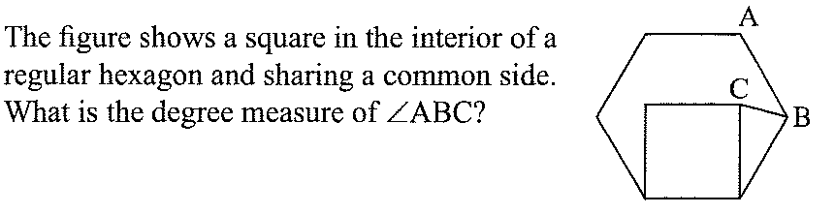
7th

Slide 34
7th
7th
Hexagons have interior angles of 120
LCDB = 120 – 90 = 30
DC = DB, so LDBC = (180 - 30)/2 = 75
LABC = 120 – 75 = 45
D

